Slide 1
Predicting Exchange Rate
24067 박성현

Slide 2
Table of Contents
Factors that Affect Exchange Rate
Data Collection & Preprocessing
Word Bank
Web Crawling (Naver)
Natural Language Processing
Time Series Analysis
Transformer
Temporal Fusion Transformer
Combining NLP with other datas (Grading System)
Analyzing Results
Conclusion

Slide 3
Factors that Affect Exchange Rate
Inflation
Interest Rates
Government Balance
Public Debt
Trading (Import/Export)
Expectations of relationship between countries
과거 패턴 중점
미래 반영 가능

Slide 4

Data Collection
World Bank API

Slide 5
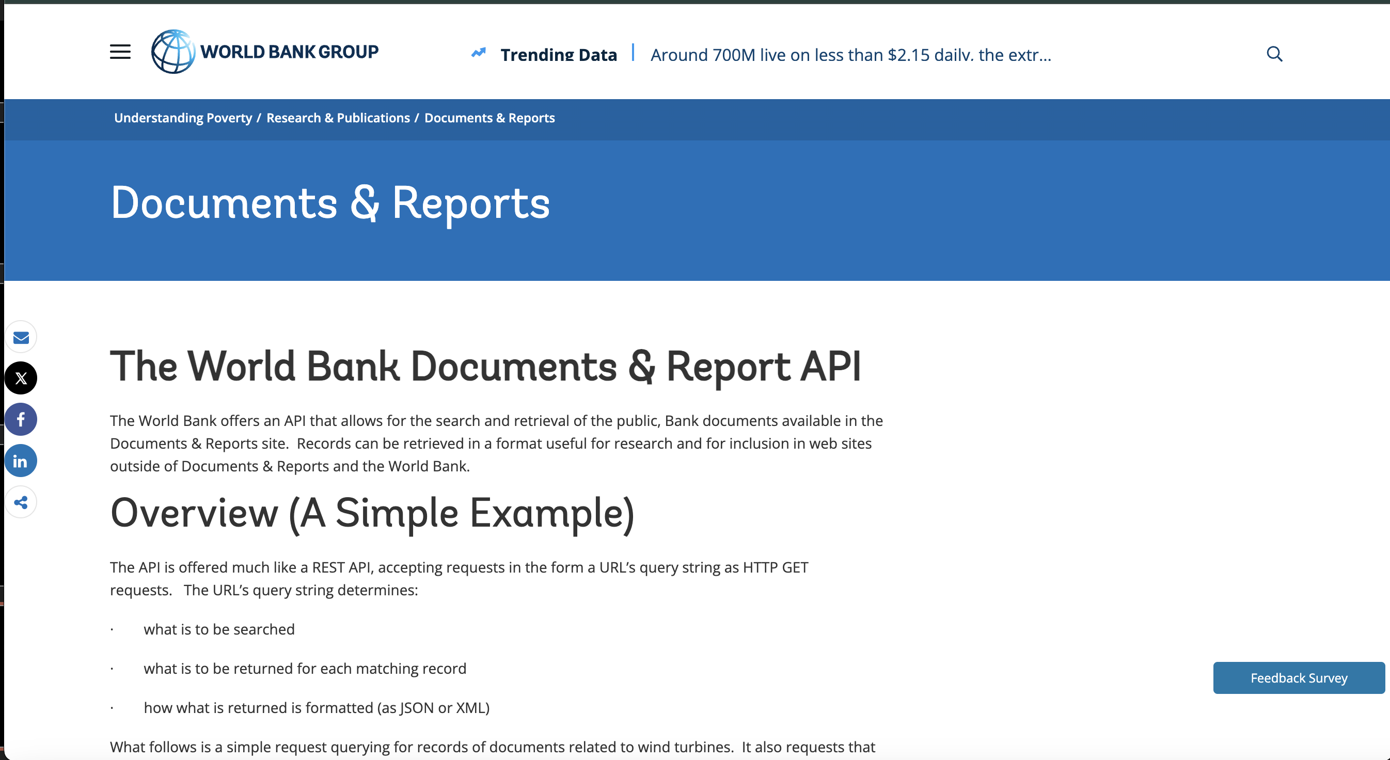
Data Collection
World Bank API

Slide 6
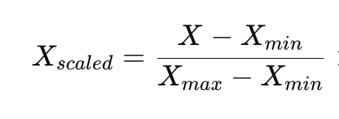
Temporal Fusion Transformer
Min-Max Scaling

Slide 7
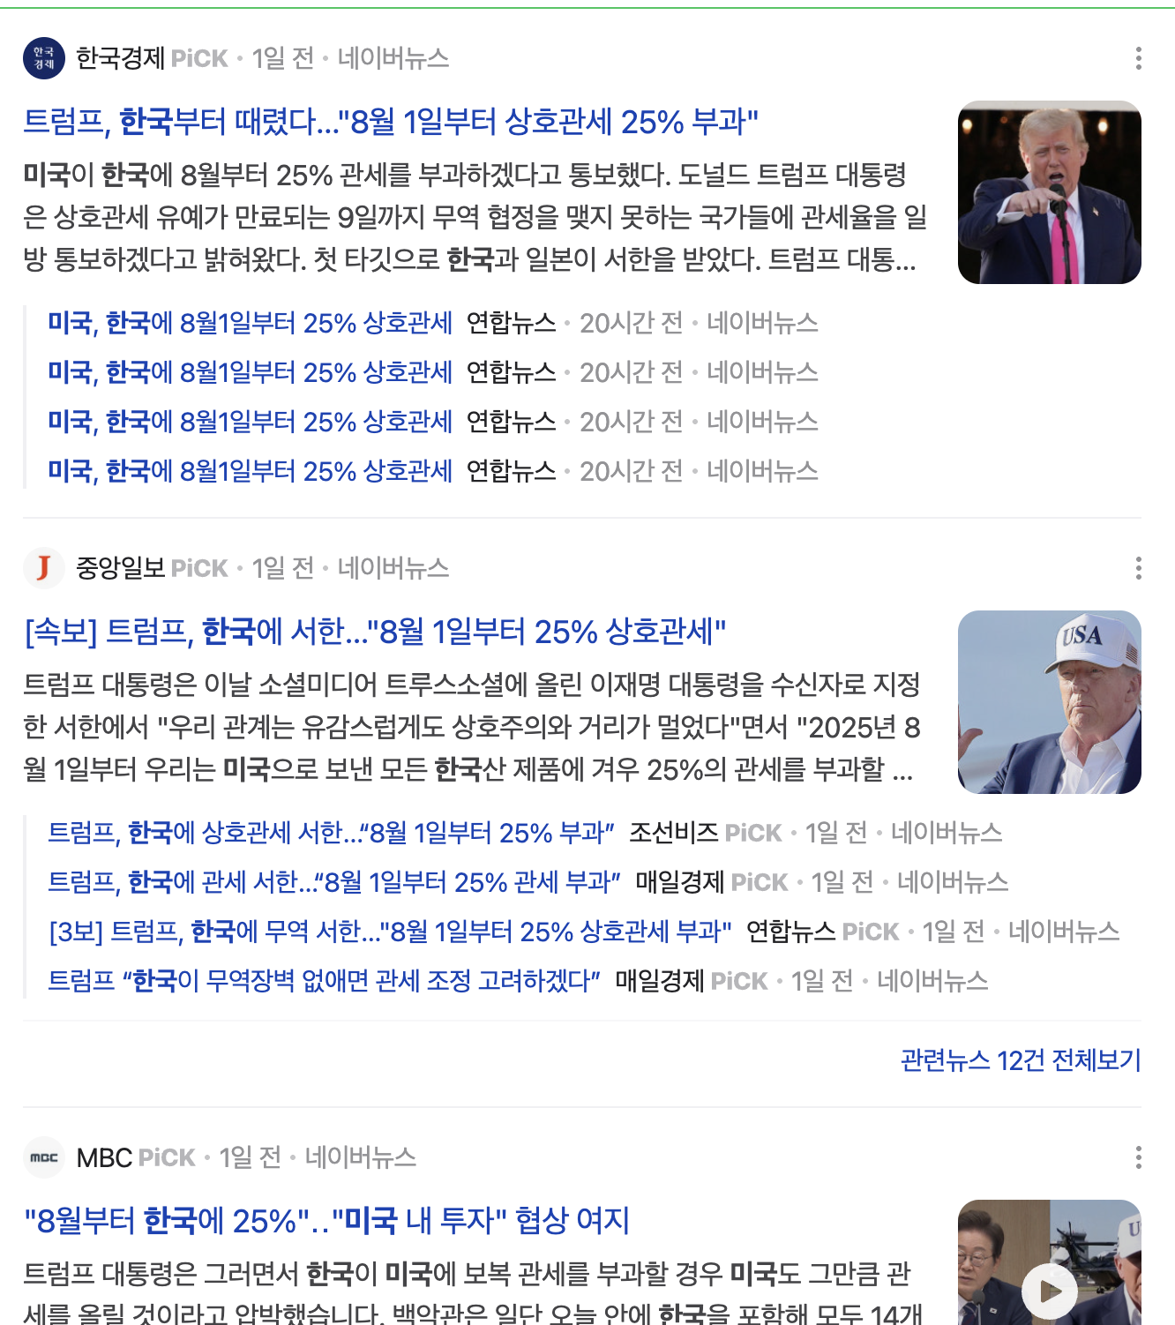
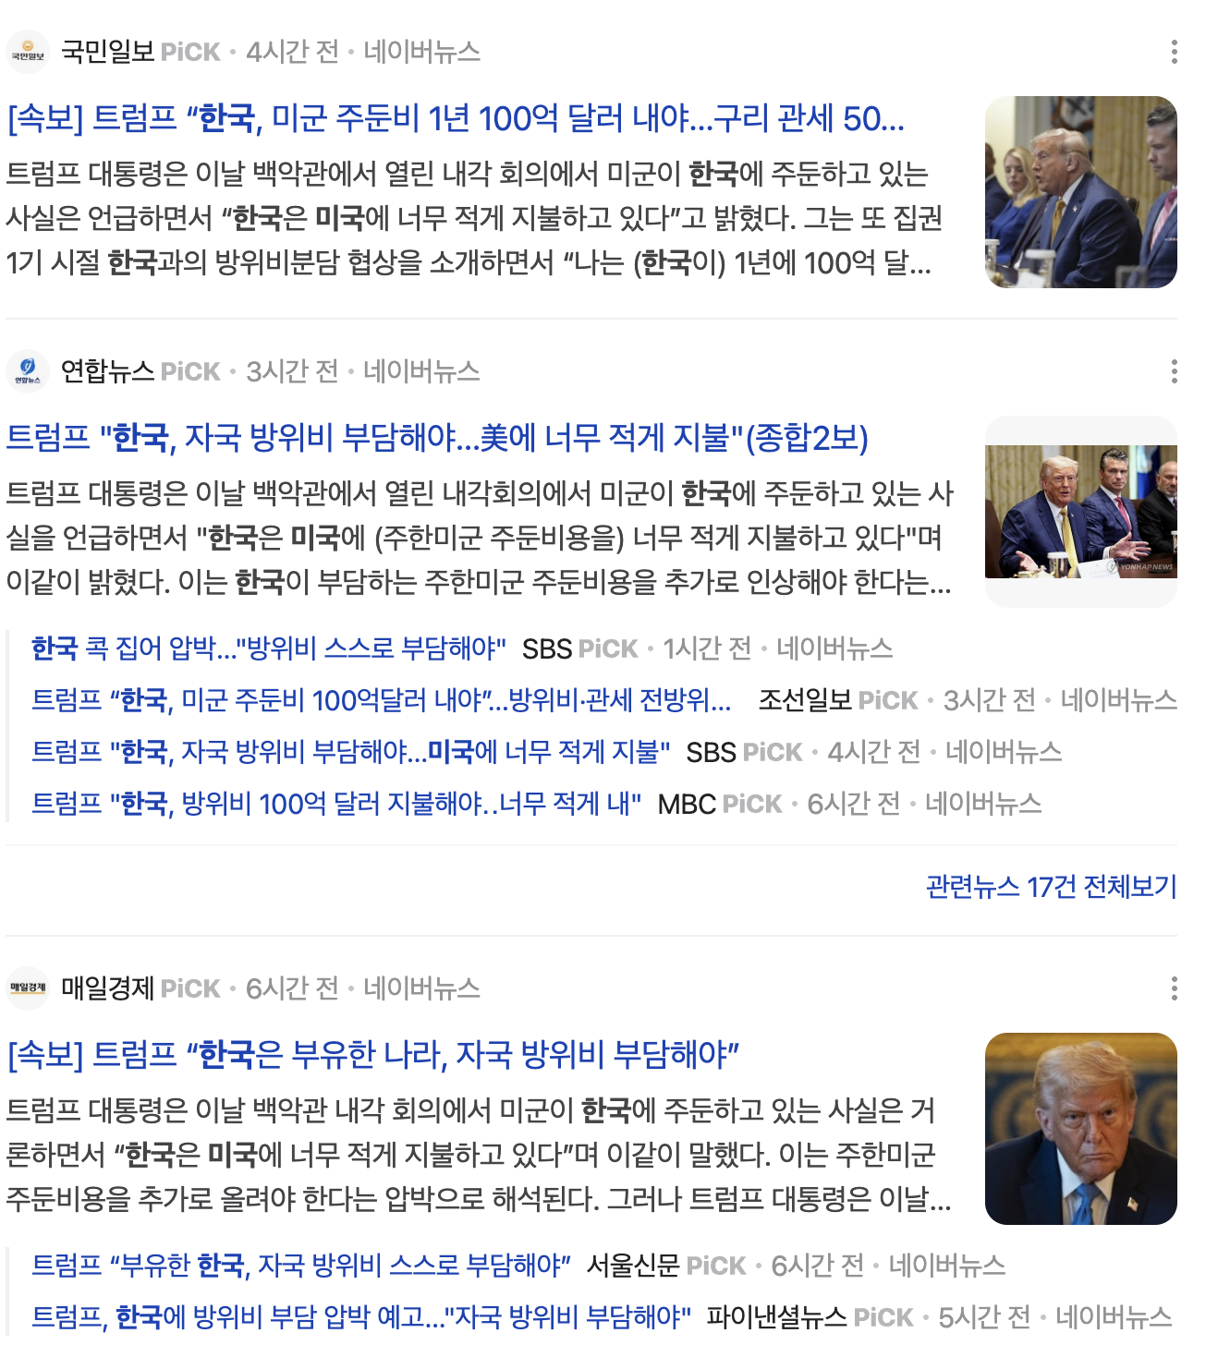
Web Crawling
Naver News

Slide 8
Web Crawling
Naver News

Slide 9
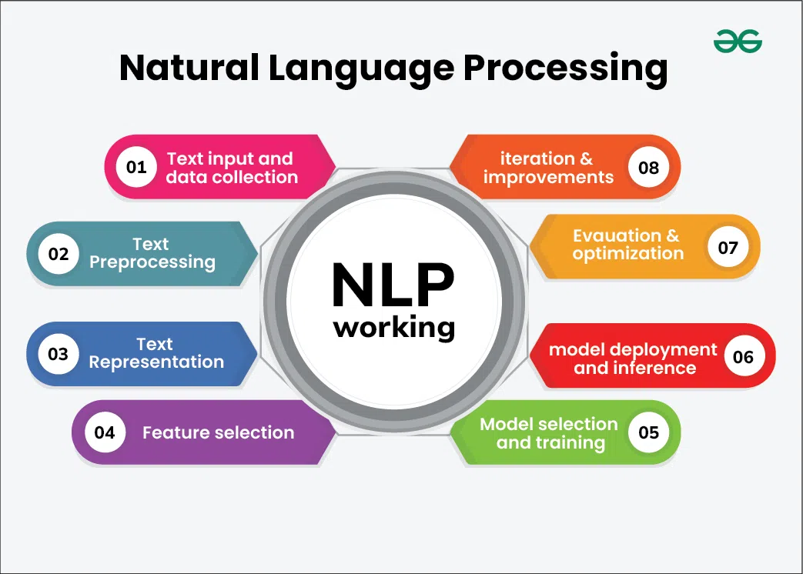
Natural Language Processing

Slide 10
Natural Language Processing
Method 1: Keyword-based Sorting
투자
공동 성명
관세 인상
무역 제재
무역 협상
관계 악화

Slide 11

Natural Language Processing
Naver News

Slide 12
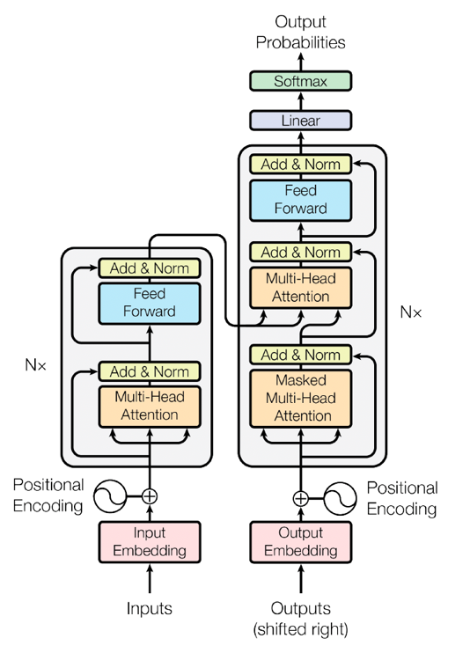
Transformer
Structure

Slide 13
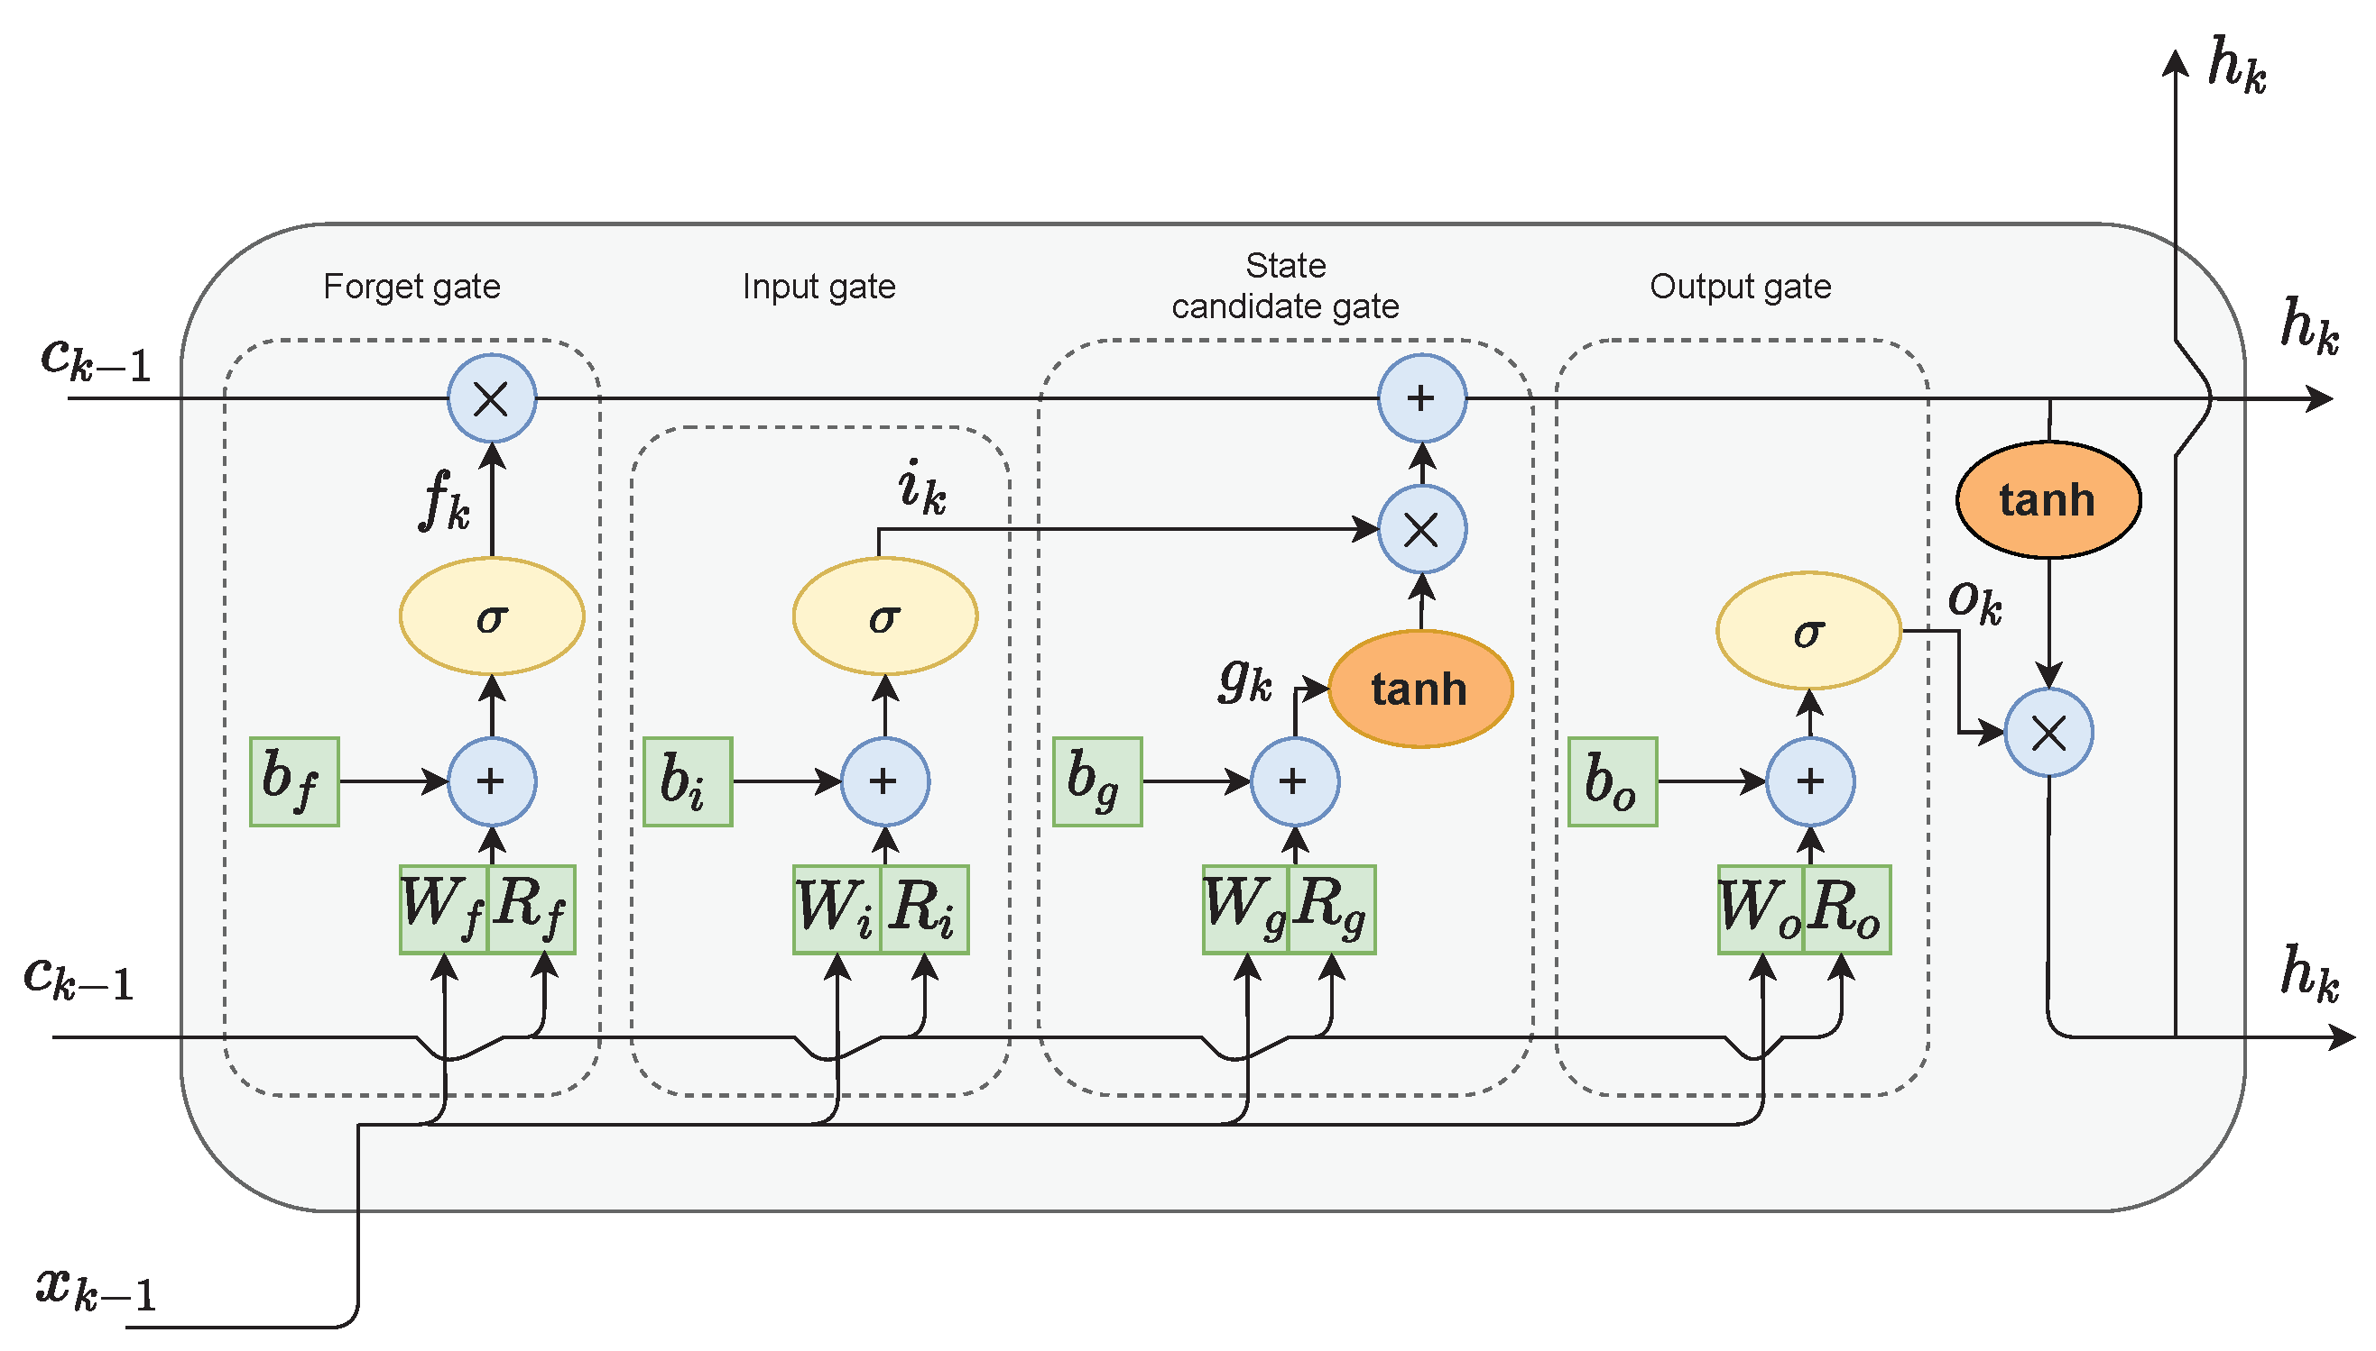
LSTM

Slide 14
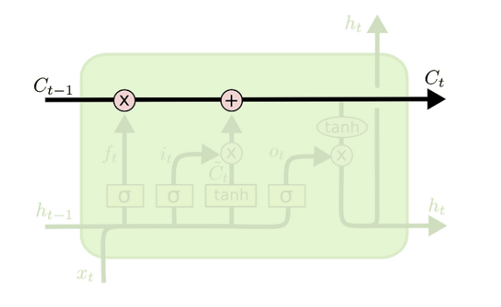
LSTM

Slide 15
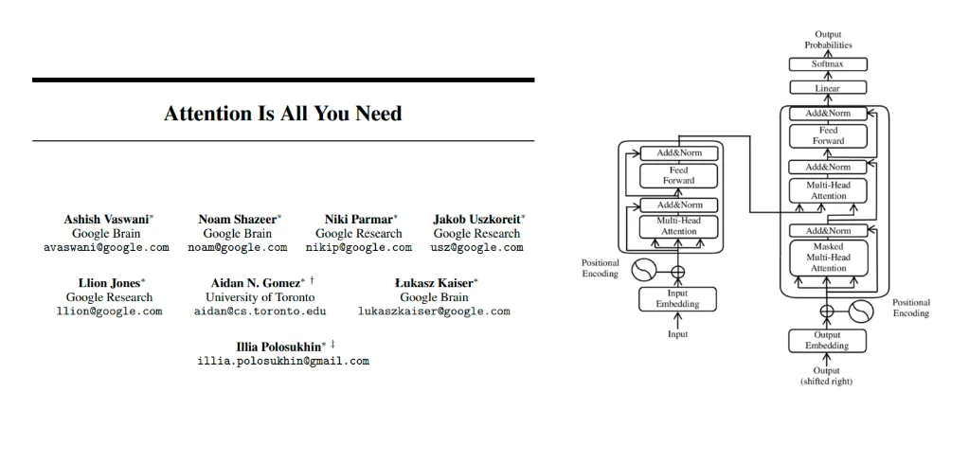
Transformer
Attention Mechanism

Slide 16
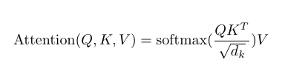
Transformer
Attention Mechanism (Scaled-Dot)

Slide 17
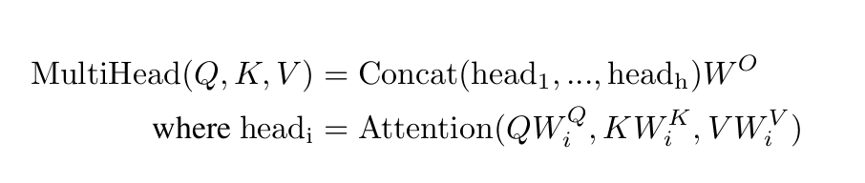
Transformer
Multi-Head Attention

Slide 18
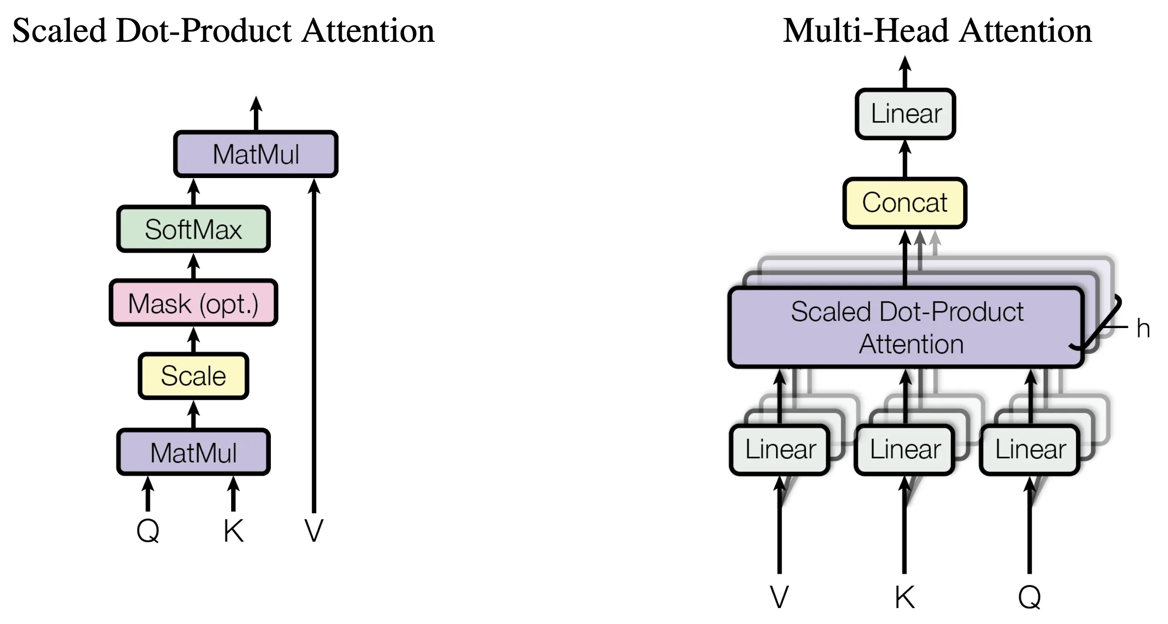
Transformer
Multi-Head Attention

Slide 19
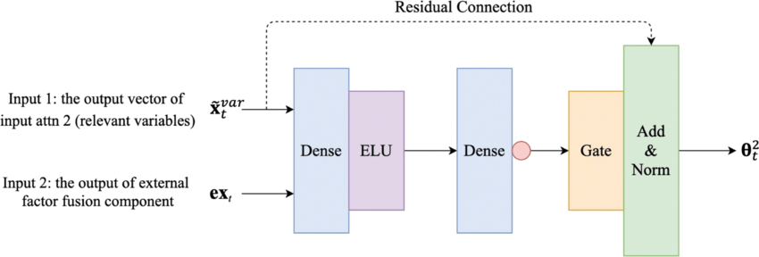
Gated Residual Network

Slide 20
Gated Residual Network
I am Sunghyun, and this is my sister.

Slide 21
Gated Residual Network
I am Sunghyun, and this is my sister.

Slide 22
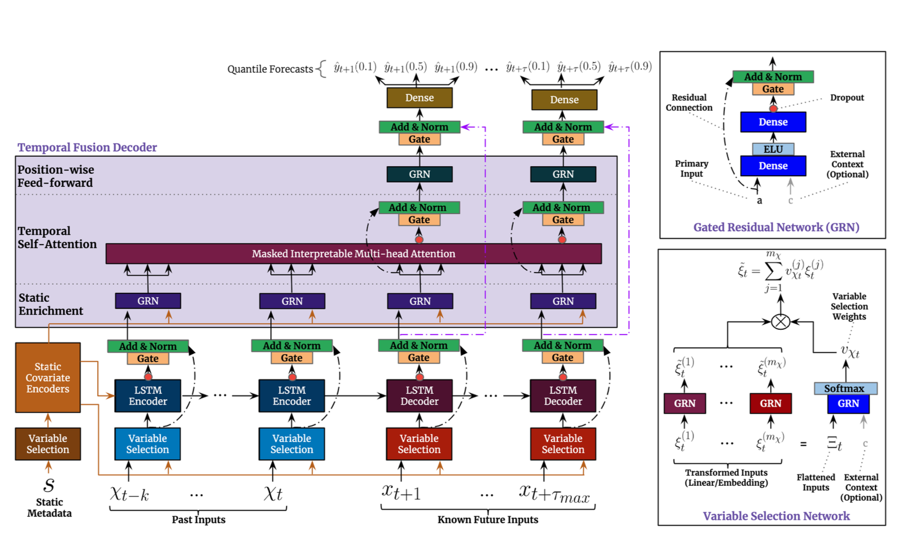
Temporal Fusion Transformer
Structure

Slide 23
Temporal Fusion Transformer
What Each Step Does

Slide 24
Combining Results (Grading System)
Very Good - 5
Good- 4
Neutral - 3
Bad - 2
Very bad

Slide 25
Combining Results (Grading System)
Time-Based Analysis
Language-Based Anaysis
8%~ - 5
Very Good - 5
4% ~ 8% - 4
Good- 4
-4% ~ 0% - 3
Neutral - 3
-8% ~ - 4% -1
Bad - 2
-8%~ - 0
Very bad - 1

Slide 26
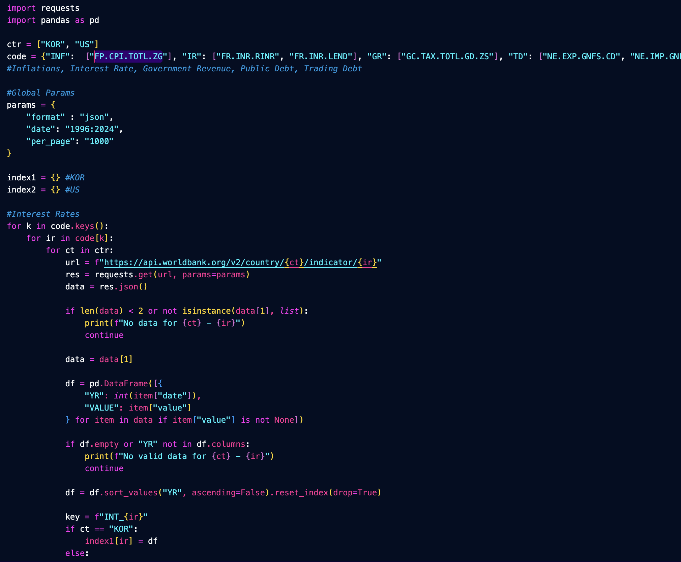
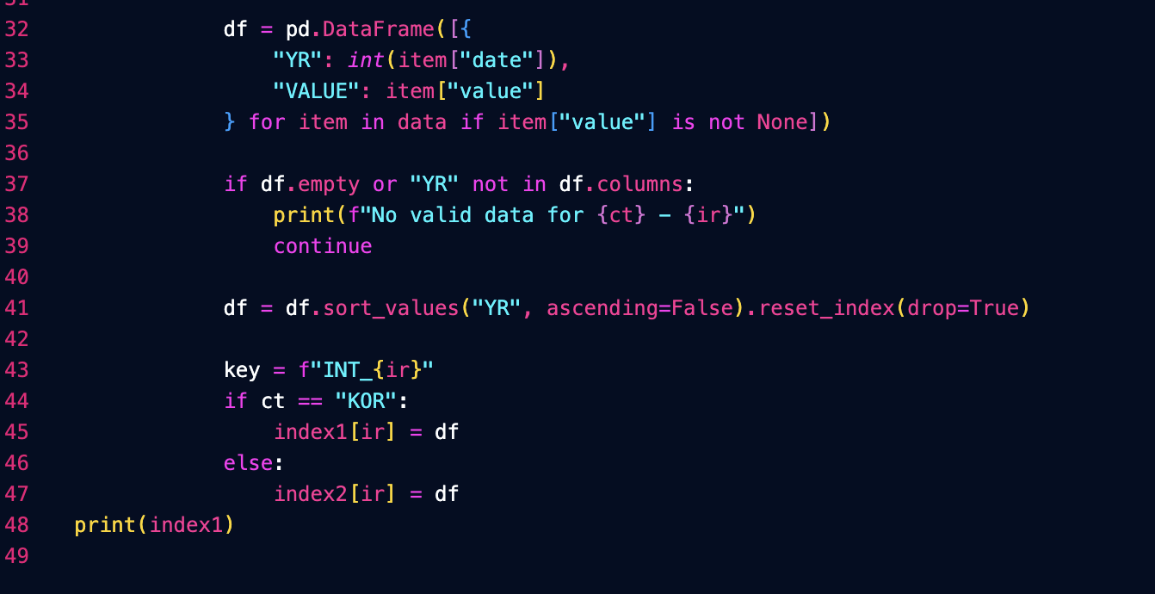
Codes

Slide 27
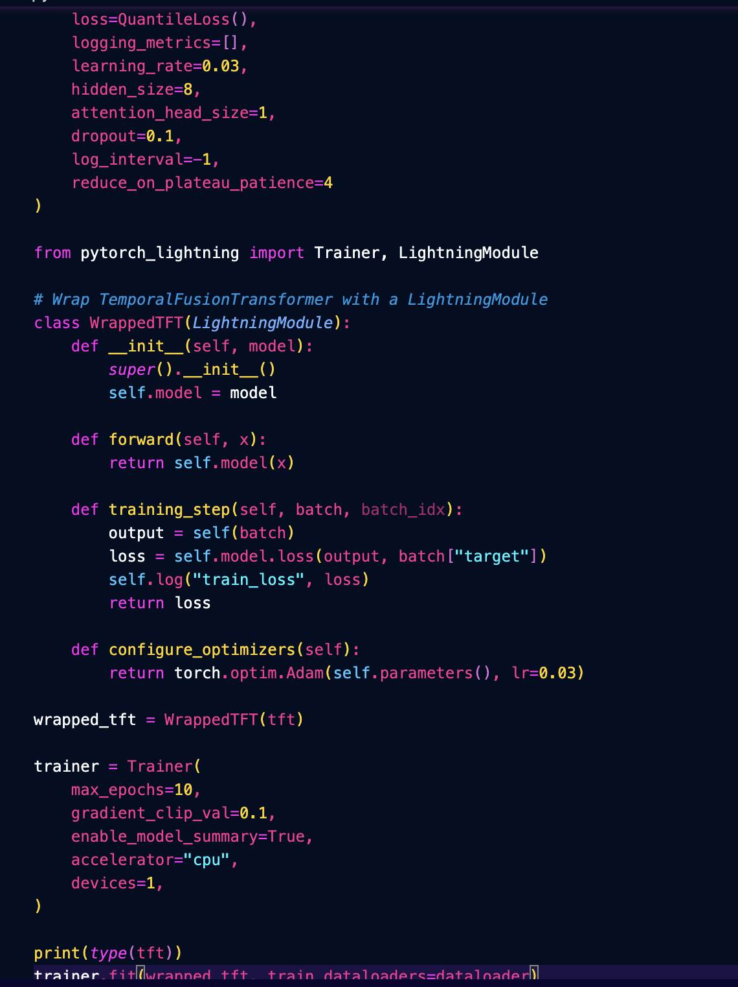
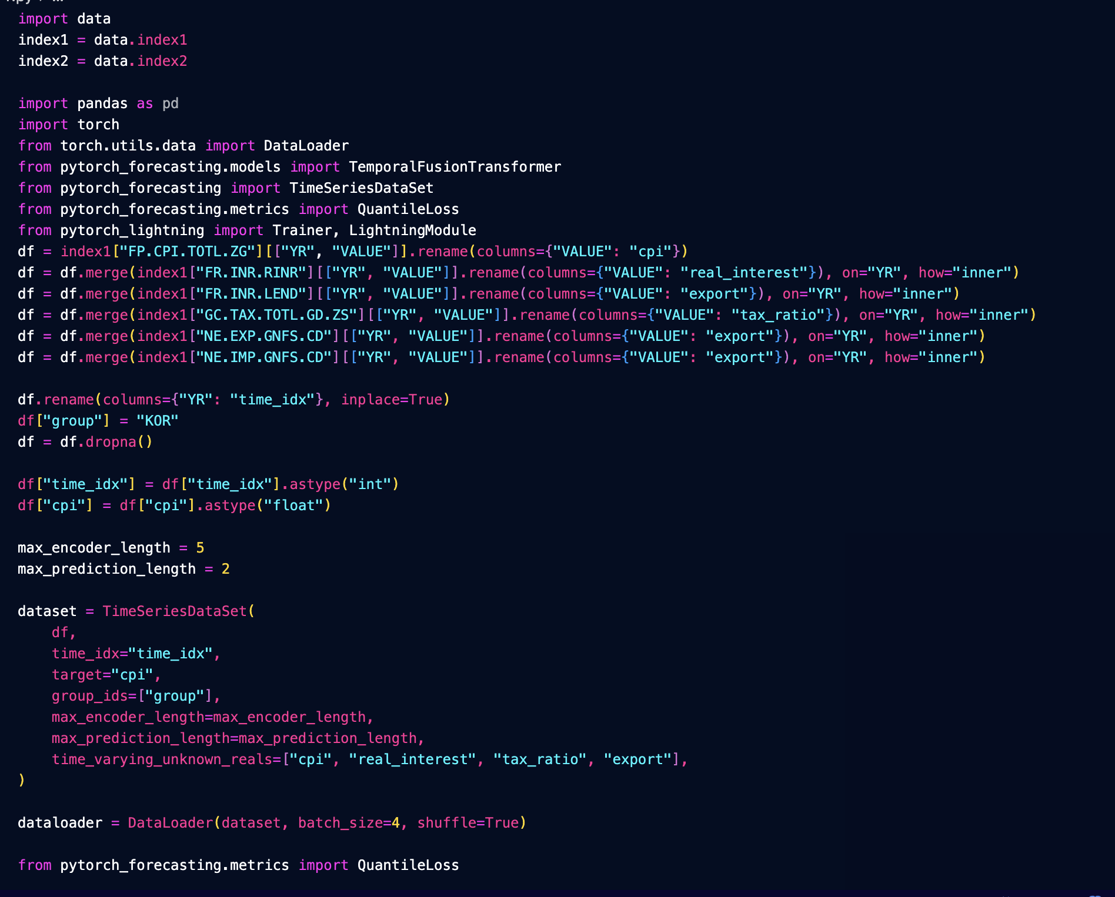
Codes

Slide 28
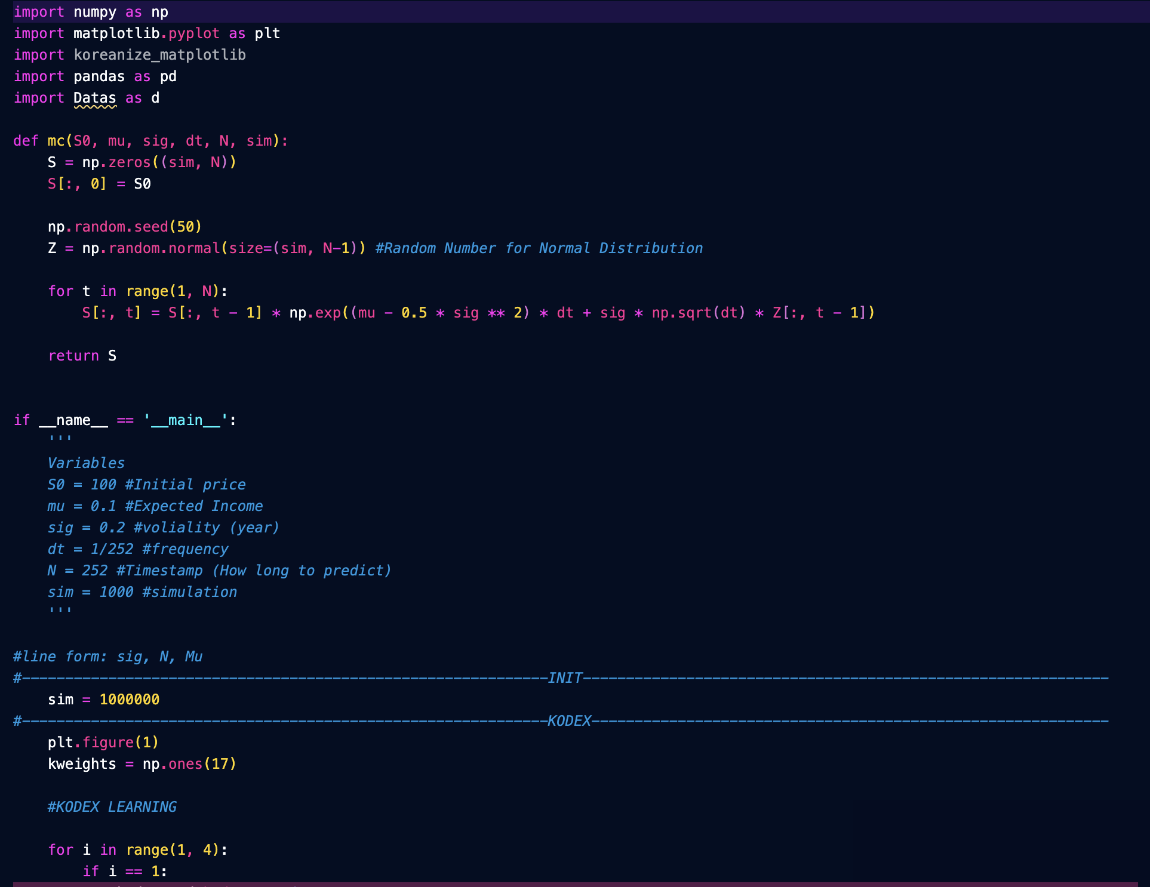
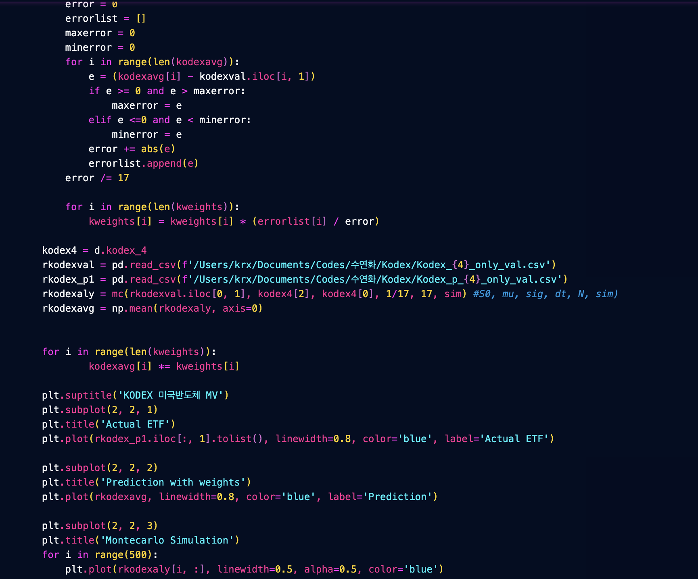
Codes

Slide 29
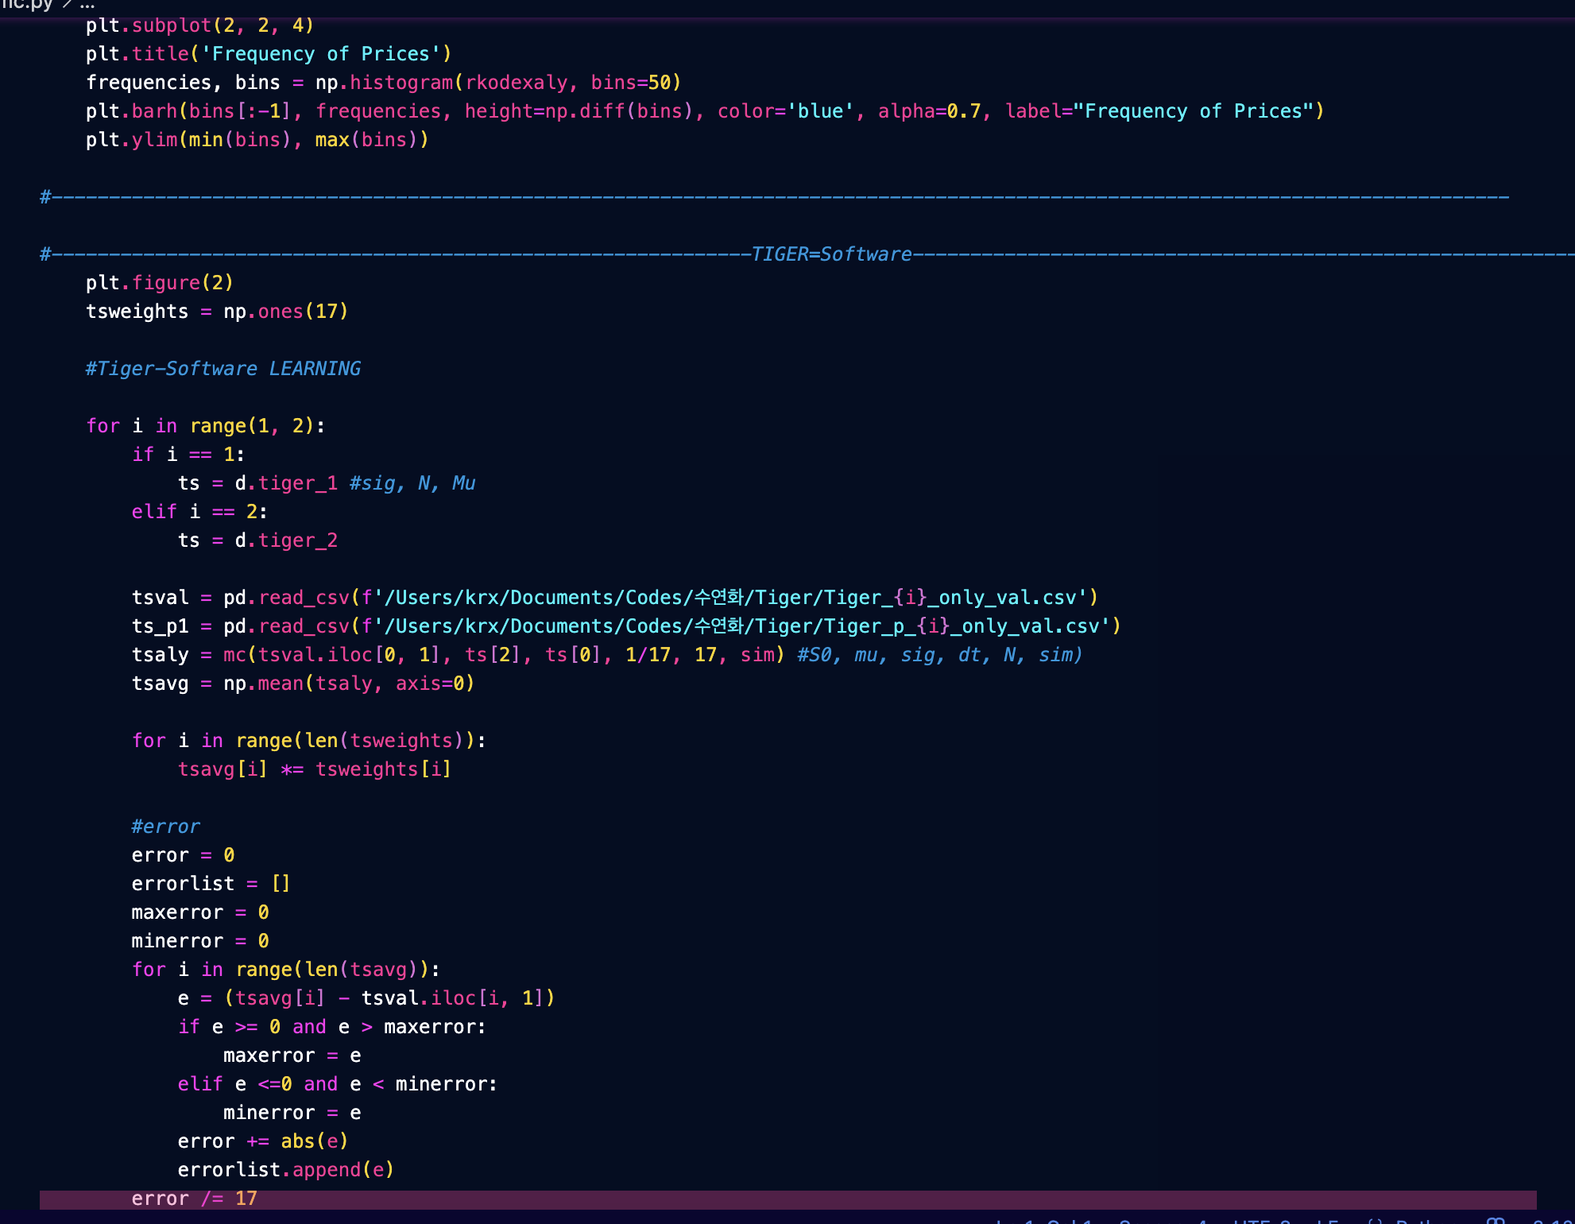
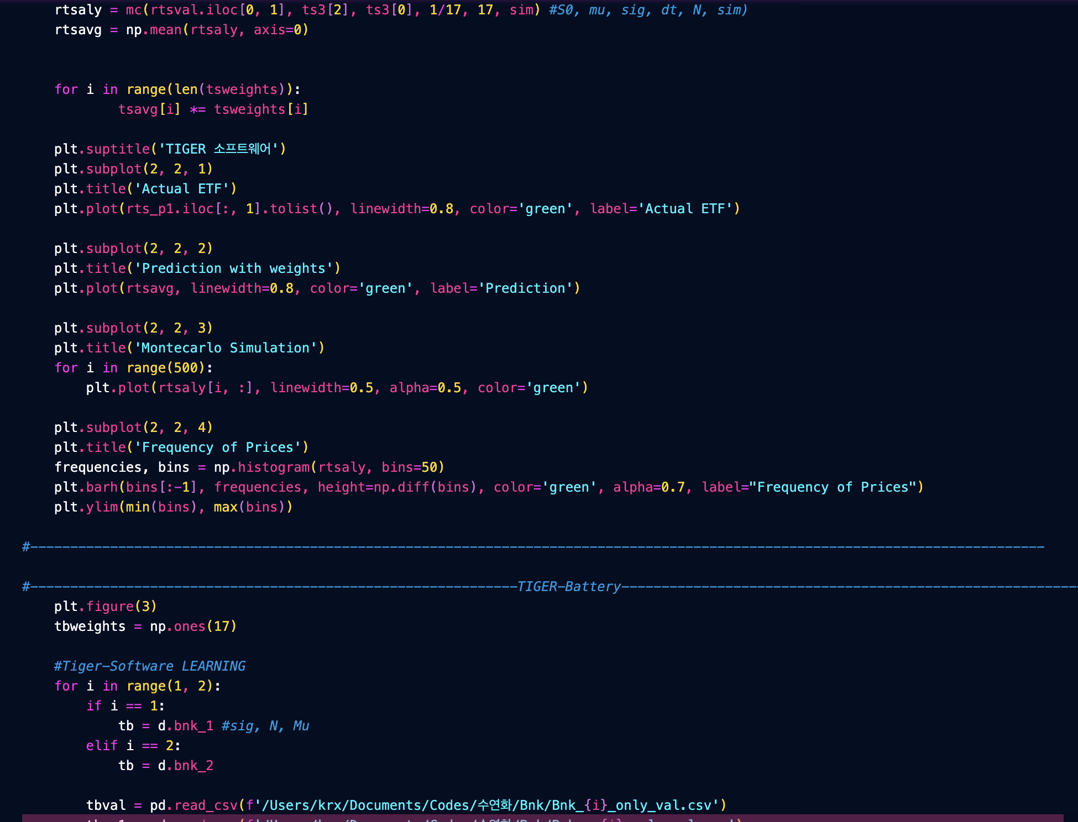
Codes

Slide 30
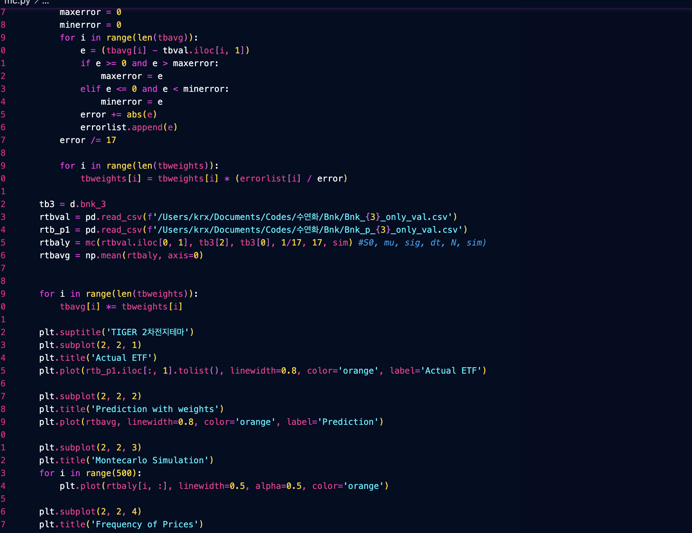
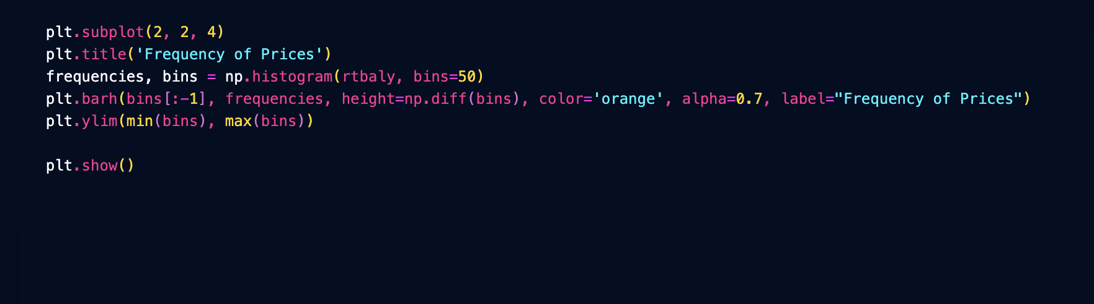
Codes

Slide 31
Results
Time-Based Analysis
Language-Based Analysis
4% ~ 8% - 4
Bad - 2

Slide 32
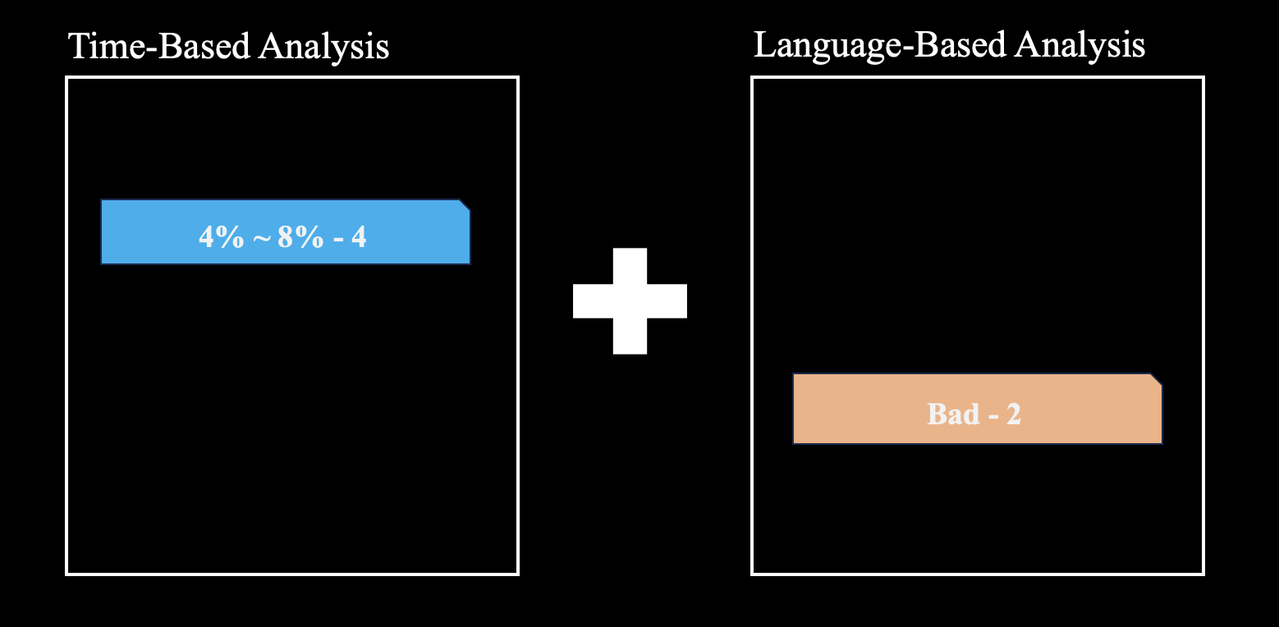
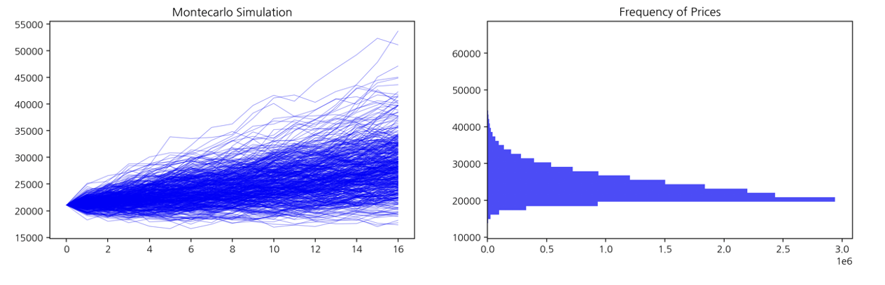
Comparison
Prediction with separation of numerical / Political & Economical factors
Prediction with Brownian motion

Slide 33
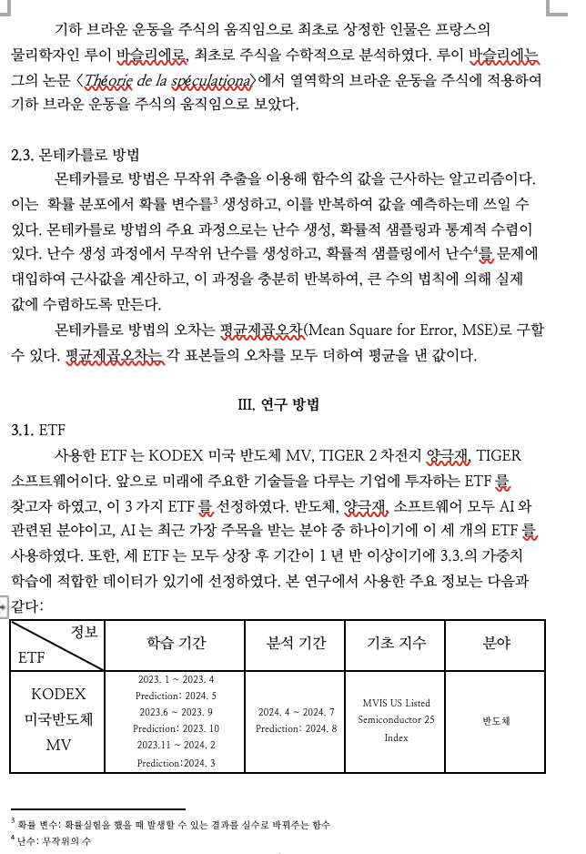
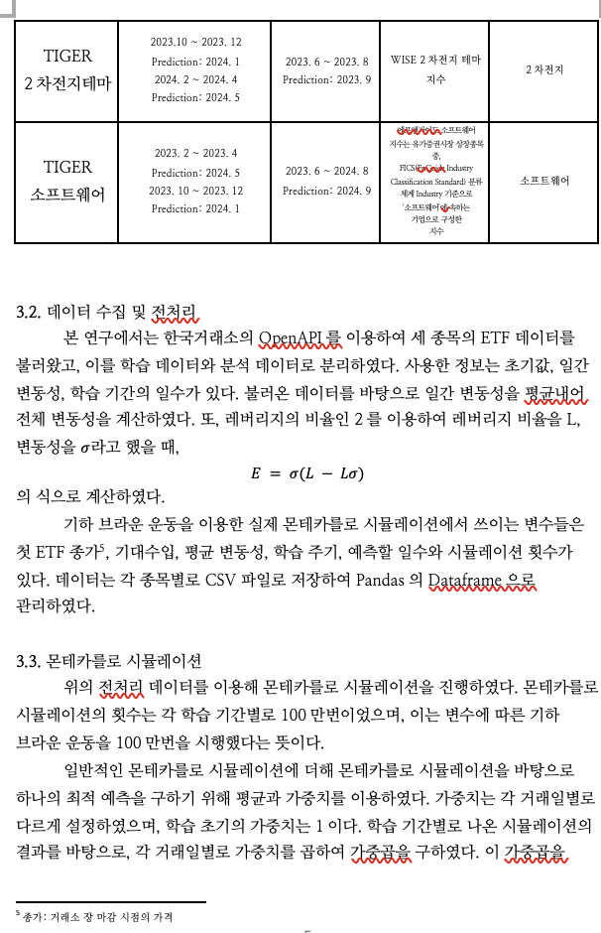
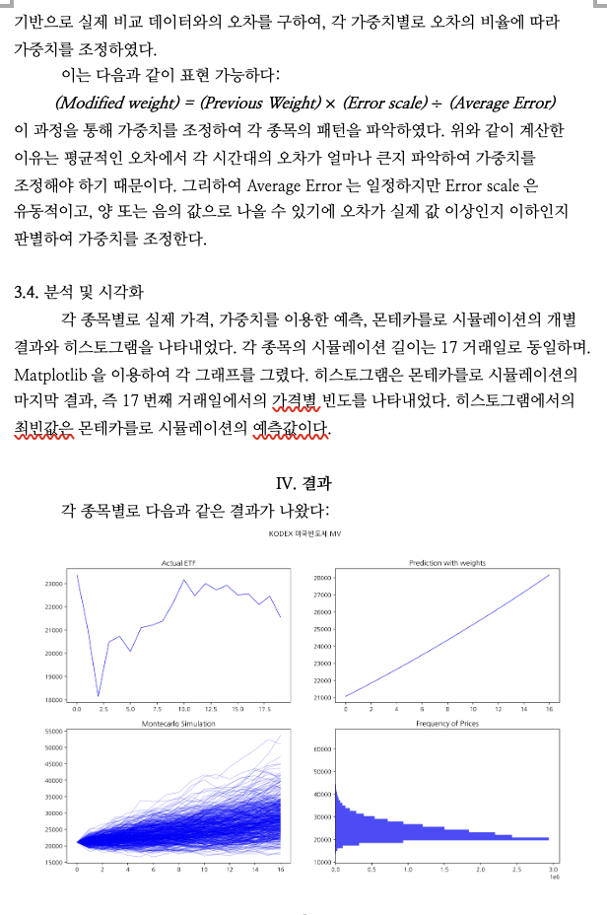
Comparison

Slide 34
Results
환율 오를 것으로 예상 / 실제로 2024년에 오름

Slide 35
Limitations
TFT에서 Min-Max Scaling의 한계
각 요소를 독립적으로 분석하고, 요소들의 영향력을 더욱 파악하여 개벌 처리를 통한 통합을 하였으면 좋았을 것.
Grading System이 상당히 단편적이며 특히 Time-Based Attention의 Grading은 임의로 지정함.
NLP의 긍정/부정 판별이 단편적임.

Slide 36
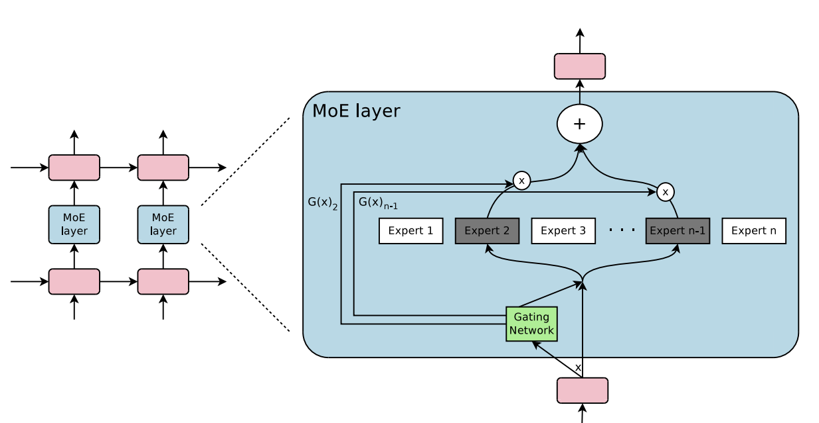
Index 만들기
Plans
NLP 강화 (Cosine Similarity, Sentiment Analysis)
MoE algorithm (Priority)
각 요소의 특성을 살려 개별 분석 후 종합하기
Scaling 조정: 변화율, 실제 값 등을 반영 / 무작정 Min-Max Scaling을 하기 전에 각 값의 변화를 따지기
Long-term과 Short-term을 나누어서 분석 후 종합

Slide 37
Plans
딥러닝을 이용한 가중합(Weighted-Sum)
환율 영향 요소 추가

Slide 38
Citations
Vaswani, Ashish, et al. "Attention is All You Need." Advances in Neural Information Processing Systems, vol. 30, 2017. arXiv:1706.03762. https://arxiv.org/abs/1706.03762
Lim, Bryan, et al. "Temporal Fusion Transformers for Interpretable Multi-horizon Time Series Forecasting." International Journal of Forecasting, vol. 38, no. 4, 2022, pp. 1454–1471. arXiv:1912.09363. https://arxiv.org/abs/1912.09363
Hochreiter, S., & Schmidhuber, J. (1997). Long short-term memory. Neural Computation, 9(8), 1735–1780. https://doi.org/10.1162/neco.1997.9.8.1735
2024 2학기 수업량 유연화

